Slide 1
“Love Pelham” Survey Results
Presented by the Junior League of Pelham
to the Pelham Chamber of Commerce
March 1, 2016

Slide 2
PROJECT overview
Each year, the provisional members of the Junior League of Pelham collaborate on a class project that aims to serve the local community
This year our project focused on raising awareness of, and encouraging greater community engagement with, our local businesses
Our beneficiary for this project is the Pelham Chamber of Commerce

Slide 3
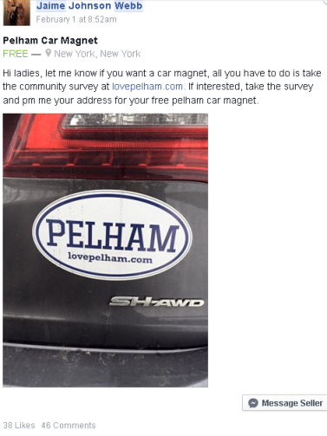
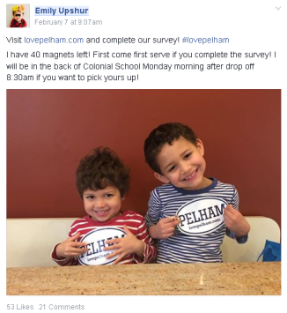
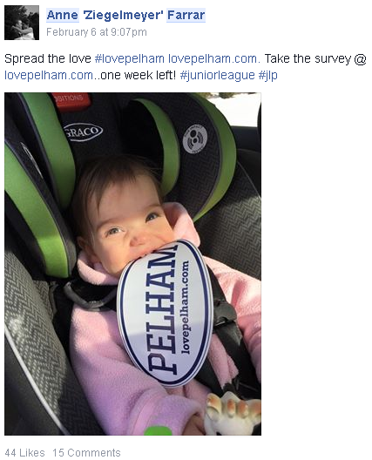
Methodology
Online survey at lovepelham.com
12/15/15 through 2/14/16
Focused on three key categories: dining, shopping, and services
Promotion of survey:
Social media
Palm cards
Car magnets incentive
Local businesses
Junior League of Pelham
Local email listservs
Word of mouth

Slide 4
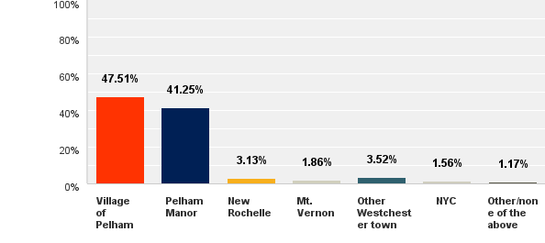
DEMOGRAPHICS
Over 1,000 surveys were completed
Approximately 90% of participants live in Pelham Manor or the Village of Pelham
Q: In which town do you live?

Slide 5
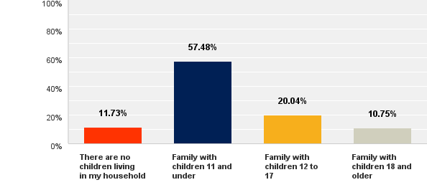
DEMOGRAPHICS
Less than 12% of participants have no children living at home
Nearly 60% have children 11 and under living at home
More than 20% have children between 12 and 18 living at home
About 10% have children over 18 living at home
Q: Which describes your household?

Slide 6
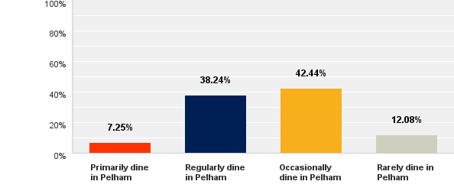
DINING Statistics
Less than 10% of participants primarily dine in Pelham
Nearly 40% dine in Pelham regularly
More than 40% dine in Pelham occasionally
About 12% rarely dine in Pelham
Q: Which of the following best describes how frequently you patronize restaurants in Pelham?

Slide 7
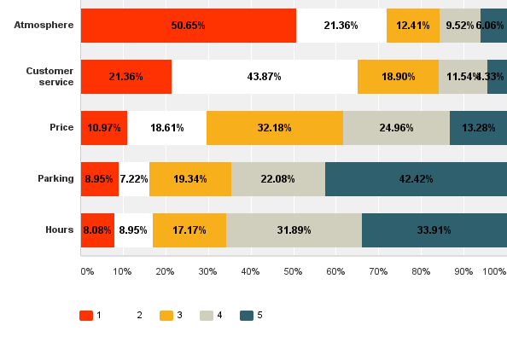
DINING statistics
When ranking 1 (most) though 5 (least), atmosphere was ranked as the most important attribute by nearly 50% of participants
Most participants ranked customer service as the second most important factor
Price, parking and hours were the least important attributes for most participants
Q: Focusing on the DINING experience that Pelham provides, rank the following factors from most important to least important on a scale of 1 (most important) to 5 (least important). You may only use each number (1, 2, 3, 4, and 5) once.

Slide 8
DINING feedback
What they love:
Establishments like Bistro Rollin, La Fontanella, and Café Regatta
New additions like Sakura, Prime 16, Sergio’s Ristorante, Soula’s Kitchen
What they think needs improvement:
Primarily Italian dining options, more variety is needed
E.g., Mexican or Indian
Lack of “atmosphere” compared to NYC and other Westchester towns
More chain establishments on Wolf’s Lane/Fifth Avenue
E.g., Starbucks, Le Pain Quotidien, Panera
More child-friendly establishments
E.g., offering basics such as crayons
“There are several great restaurants in town. But… lack of variety, especially good ethnic options
…and youthful energy.”
“I try to eat in Pelham, but find that I enjoy the experience more in surrounding towns (Larchmont, Port Chester, Arthur Ave). Better food, variety and nightlife generally than Pelham. Generally, I'd prefer to stay local but Pelham doesn't always have what I'm looking for.”

Slide 9
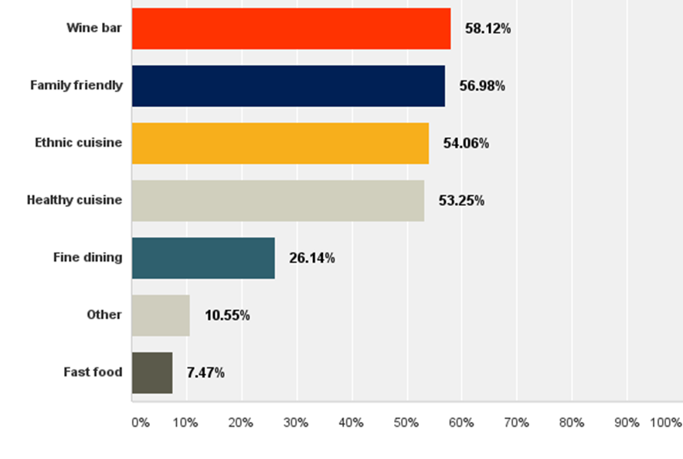
DINING opportunities
Most participants were very interested in a wine bar, as well as more family friendly, ethnic, and health food establishments
Q: Is there a type of restaurant that you would like more of in Pelham? (check all that apply)
“Lots of options but all could use a little tweaking. Some rarely change menus or don't have decent wine selections. Would love a Chat 19 or Vintage 1891 type location.”

Slide 10
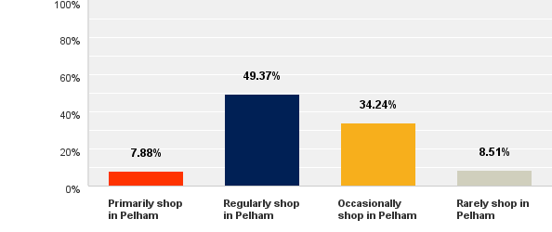
retail Statistics
Less than 10% of participants primarily shop in Pelham
Nearly 50% shop in Pelham regularly
Almost 35% shop in Pelham occasionally
About 8.5% rarely shop in Pelham
Q: Which of the following best describes how frequently you patronize stores in Pelham?

Slide 11
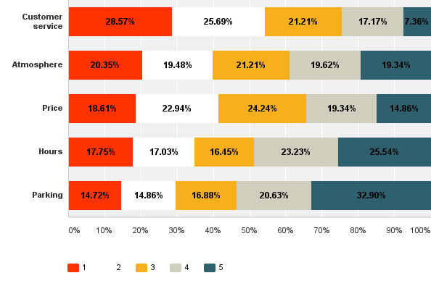
Retail statistics
When ranking 1 (most) though 5 (least), customer service was ranked as the most important attribute by nearly 30% of participants
Most participants ranked price or atmosphere as the second most important factor
Hours and parking were the least important attributes for most participants, but were mentioned frequently in comments nonetheless
Q: Focusing on the SHOPPING experience that Pelham provides, rank the following factors from most important to least important on a scale of 1 (most important) to 5 (least important). You may only use each number (1, 2, 3, 4, and 5) once.

Slide 12
retail feedback
“I have never been inside of most shops on Fifth Avenue because they're closed when I'm home from work."
What they love:
Grocery shopping experience in Pelham
Good customer service
The diversity of shops and want more
The shops that feel bright and modern
What they think needs improvement:
Greater selection of products that meet their needs
Longer hours especially for city commuters
More/cheaper parking options and less aggressive ticketing
"Love supporting the local shops. Love the diversity of shops in the Village and hoping for more to come."
"I patronize stores that look nice…I want to reward businesses that invest in making Pelham better."
"Wish more stores were open on Sunday! I was recently trying to buy a gift and went to 4 local Pelham stores before I gave up.”

Slide 13
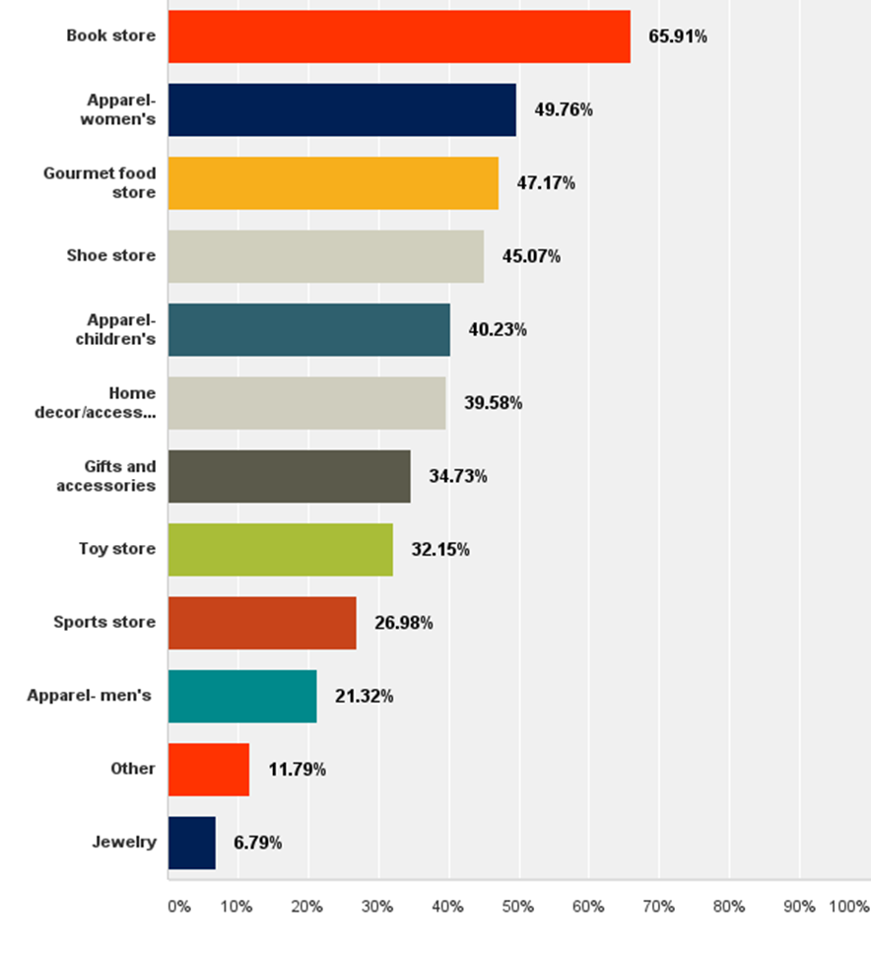
retail opportunities
Q: Is there a type of shop that you would like more of in Pelham? (check all that apply)
Participants were very interested in a book store, as well as more women’s apparel, gourmet food, and shoe stores
"Pelham retail competes with Manhattan, and young spenders have Manhattan fashion tastes."
"Stronger merchandising of the retail windows, lighting, and a better selection of more upscale shopping downtown with evening hours would encourage people to stroll around before or after dinner and make purchases.”

Slide 14
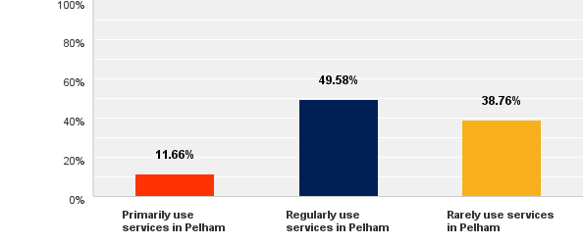
SERVICE Statistics
Less than 12% of participants primarily use services in Pelham
Nearly 50% use services in Pelham regularly
No participants indicate that they use services in Pelham occasionally
About 39% indicated that they rarely use services in Pelham
Q: Which of the following best describes how frequently you patronize services in Pelham? (e.g. salon, spa, medical, legal, financial, home improvement)?

Slide 15
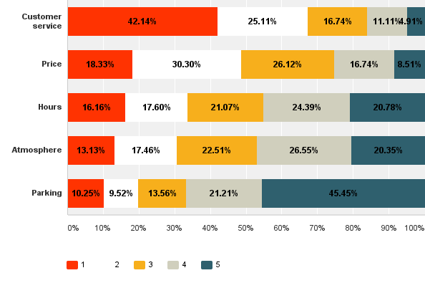
SERVICE statistics
When ranking 1 (most) though 5 (least), customer service was ranked as the most important attribute by more than 40% of participants
Most participants ranked price or hours as the second most important factor
Atmosphere and parking were the least important attributes for most participants
Q: Focusing on the SERVICE experience that Pelham provides, rank the following factors from most important to least important on a scale of 1 (most important) to 5 (least important). You may only use each number (1, 2, 3, 4, and 5) once.

Slide 16
SERVICE feedback
“Just started to get my hair and nails done in Pelham. Really happy
I made the switch."
What they love:
Local stores are very convenient
e.g., banking, hair/nail salons/barbers, spa/fitness
What they think needs improvement:
Store hours not convenient for working people
Would shop locally if hours were extended
Desire more variety
"We use the town when we can but could use more options."
"I work full time in the city and find it easier to do it there. The Pelham vendor hours are not conducive to full time working people."
“I would always prefer to patronize a mom and pop over a chain, but not just because they're local. That's not enough."

Slide 17
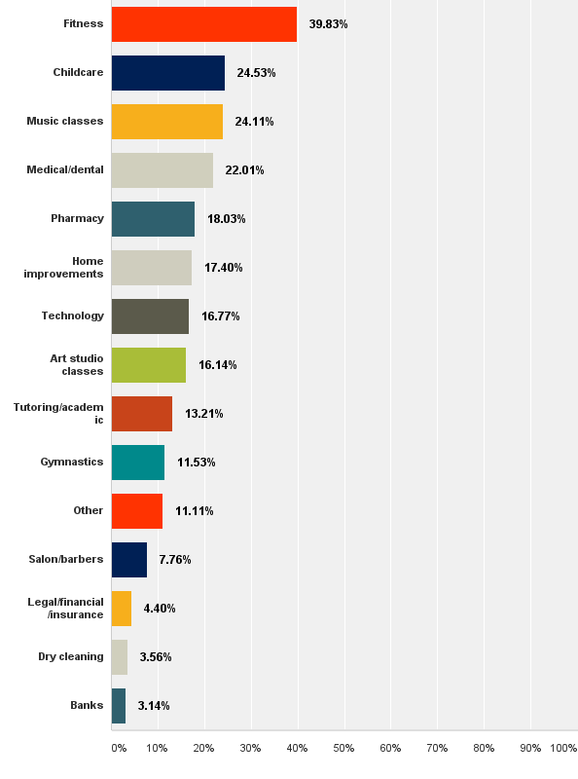
Q: Is there a type of service that you would like more of in Pelham? (check all that apply)
SERVICE opportunities
Most participants were very interested in fitness, as well as more childcare, music classes, and medical/dental services
Participants seemed unaware of certain services that are already offered, e.g., numerous requests for a yoga studio (Radiate) or juice bar (Pure Bliss)
"Would LOVE to see a spin or yoga studio right in downtown Pelham. Would bring a lot of traffic to town and would support other businesses (coffee shops, juice bars, etc.)"

Slide 18
Key TAKEAWAYS
What they love:
Great service, personal attention, knowledgeable staff
A sense of community, small town feel
”Business owners know you and you know them"
Friendly atmosphere; convenience, proximity to home
What they think needs improvement:
More “charming” storefront appeal
Greater diversity of options
Extended hours: weekday evenings and weekends
The Love Pelham survey also generated a list of over 120 email addresses of Pelham residents interested in forming a committee for local improvement and revitalization!
“I'd be happy to pay a few dollars more in exchange for a thriving local community.”
"I love that there are no major chains but I just wish there were more options generally.”
“We are … underserved in Pelham with good restaurants and thoughtful, boutique, well-merchandised retail destinations."

Slide 19
CONCLUSION
Although they see room for improvement…
People LOVE PELHAM!
Huge interest, response and participation in this project
Strong love for the Pelham community
Desire to be drawn into downtown Pelham
“Hurricane Sandy is a[n] excellent example. Although a few years ago, we will never forget the kindness of [DeCiccos]. Offering their freezers, telling my husband (who forgot his wallet) to come back later to pay - they let him wheel out over $200 worth of groceries --who does that?!!! They are beyond awesome. They are [an] anchor of this community.”

Slide 20
THANK YOU FOR YOUR SUPPORT OF THE “LOVE PELHAM” PROJECT
Pelham Chamber of Commerce Mission
Working as a unified network of Pelham businesses, our goal is to collaborate and initiate ideas and strategies to help increase sales and grow business.
Pelham Chamber of Commerce Vision
We strive to improve the spirit of enterprise and community that will result in an enhanced quality of life for all of Pelham.

